Slide 1
PSYC10009: Biological Psychology
Dr David Turk

Slide 2
Lecture 11: Learning and Memory
Compulsory Reading:
Reading:
Kalat, Chapter 13
Schacter et al. First International Edition Text Book, Chapter 5)
The exam MAY contain material NOT covered in the lecture.

Slide 3
Types of Memory
Hebb (1949) argued that memory is not a unitary construct but could be thought of in terms of:
Short-Term Memory: For events that have just occurred.
Long-Term Memory: For events further back in time.
It was thought that if a short-term memory was forgotten then it was lost forever. If not it would be consolidated into long-term memory.
Problem:
Some memories do not need to be consolidated (e.g., the score in a sports match you are watching).
Consolidation periods vary.

Slide 4
Types of Memory
Consolidation:
Some memories will take a long time to consolidate and will require a lot of effort (such as revising for this exam!)
Emotionally significant memories seem to consolidate more rapidly.
Stressful or emotionally charged experiences are accompanied by secretion of epinephrine (adrenaline) and cortisol. This activates the amygdala and hippocampus enhancing consolidation and storage of recent experiences.
The amygdala also stimulates the hippocampus and the cortex for long-term storage and consolidation of memories.
Prolonged stress leading to high cortisol also impairs memory.
Notes:
Consolidation can be a fast or slow process.

Slide 5
Types of Memory
Consolidation:
Memory is not fixed. A memory cued by a reminder is labile (it can be changed).
If the reminder is accompanied by a similar experience then the memory can be reconsolidated – strengthened again. However any new experiences during reconsolidation can actually modify the memory.
For example:
Friend: Remember the time we went to Disneyland?
Self: Oh yes.
Friend: Remember how we rode the roller-coaster and you ate popcorn and spilled it everywhere.
This will update the memory by reinforcing the details of this element of the visit at the expense of other details that may then be lost.
Notes:
Memory is changeable. It is also open to suggestion in this way by introducing elements that didn’t occur.

Slide 6
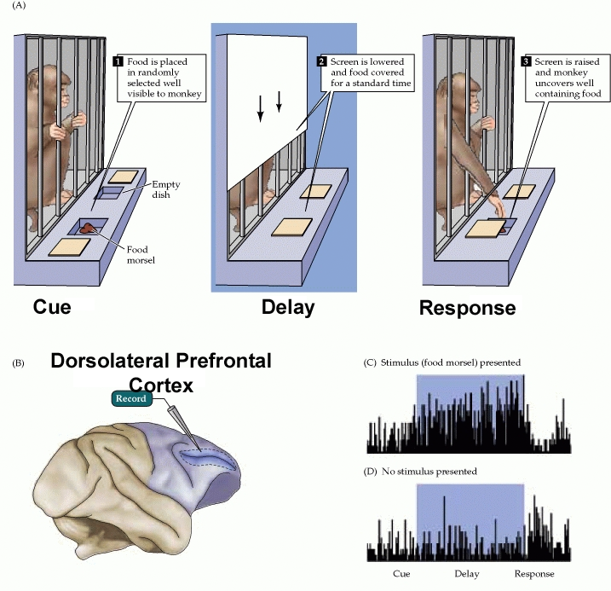
Working Memory
Storage of information while we are WORKING with it.
Notes:
Delayed Response Task. During the delay the learned has to store a representation of the stimulus. PFC active in the storage period so suggest PFC important for storage in WM.

Slide 7
Working Memory
Aged monkeys have fewer neurons and reduced input connections to PFC.
Older humans have impaired working memory abilities. Decline in memory performance linked to reduced PFC activity in older adults.
Older people with intact memory ability show even greater PFC activation than younger controls – PFC working harder to maintain performance levels and to compensate.
Stimulant drugs linked to dopamine receptors improve memory performance in aged monkeys.
Possible treatments for failing memory?
Notes:
Delayed Response Task

Slide 8
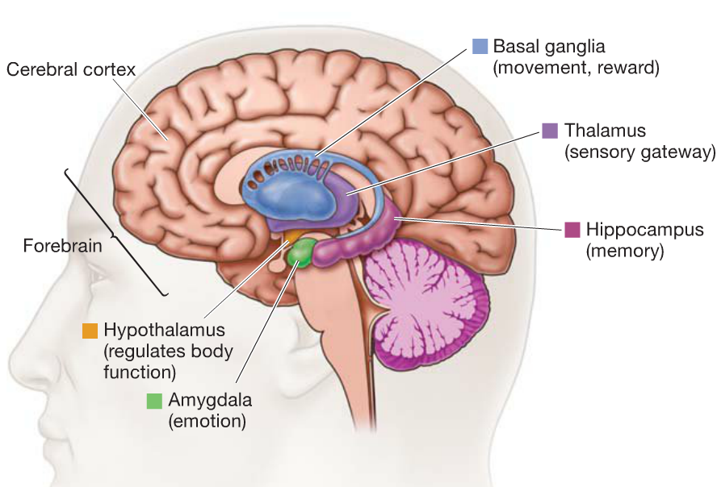
Brain Areas Associated with Memory

Slide 9
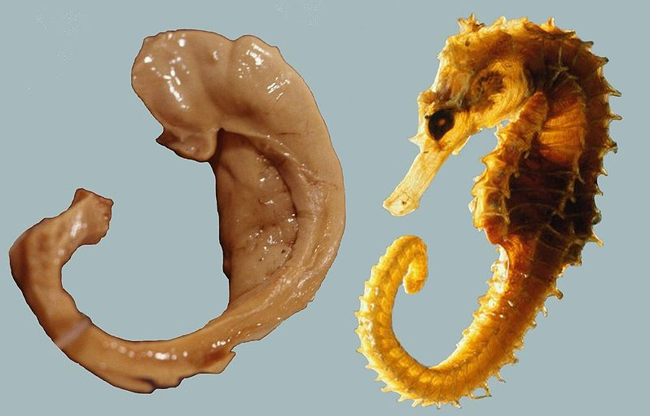
The Hippocampus (Seahorse)
Venetian anatomist Julius Caesar Aranzi (1587) first used the term.
Notes:
Also referred to it as a silkworm

Slide 10
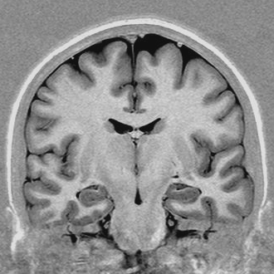
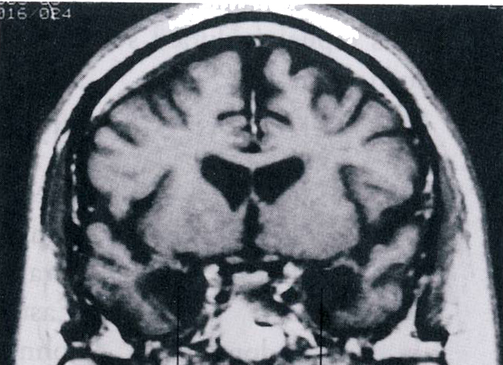
The Hippocampus (Seahorse)
Henry Molaison (HM) – removal of bilateral hippocampus and medial temporal lobe as a treatment for severe epilepsy.
Surgery was successful in reducing the seizure frequency dramatically, but at a cost.
Normal Subject
HM

Slide 11
The Hippocampus (Seahorse)
Amnesia – (From the Greek, Not Remember)
Anterograde Amnesia: Unable to form memories of events following surgery.
Retrograde Amnesia: Unable to retrieve memories prior to the surgery. Initially thought to be 1-3 years prior to surgery, but later shown to be more extensive.
HM had intact Working Memory. When asked to remember 584 he recalled it 15 minutes later.
“You remember 8, subtract it from 17 and get 9. Divide 9 in half and you get 5 and 4, and there you are, 584. Easy.”
A moment later after his attention had been distracted he had forgotten the number and his explanation of how he remembered it.

Slide 12
The Hippocampus (Seahorse)
Episodic vs Semantic Memory
HM was able to learn a few new SEMANTIC facts – names, some of whom became famous after 1953. When given first names of people who became famous after his surgery he was correct on some occasions.
First Name HM’s Response
Elvis Presley
Fidel Castro
Martin Luther King
Lyndon Johnson
Billy Graham

Slide 13
The Hippocampus (Seahorse)
Episodic vs Semantic Memory
HM was severely impaired at EPISODIC memory. He could not describe any of his experiences after the surgery. His retrograde amnesia was also most pronounced for episodic memories.
He could describe a few facts (semantic) he could relate very few personal experiences.
Patient KC also had extensive hippocampal damage and was unable to describe any event from his life but retained some factual knowledge. He can identify people and places from photos but is unable to remember any event details.

Slide 14
The Hippocampus (Seahorse)
Episodic vs Semantic Memory
Damage to the hippocampus also impairs patients in imagining the future.
Patient asked to IMAGINE a future visit to a museum.
Patient: There’s not a lot, as it happens.
Exp: So what does it look like in your imagined scene.
Patient: Well, there’s big doors, so the doors would be very big with brass handles, the ceiling would be made of glass, so there’s plenty of light coming through the centre and on either side there’d be exhibits, [pause] To be honest there’s not a lot coming…. My imagination isn’t…..well, I’m not imagining it, lets put it that way…..I’m not picturing anything at the moment.

Slide 15
The Hippocampus (Seahorse)
Implicit vs. Explicit Memory
Explicit or Declarative memory is impaired in amnesia – patients generally unable to retrieve memories on demand.
Implicit memory appears to be intact in amnesia such that prior experience can influence behaviour without conscious access to those memories.
Intact Procedural Memories
Procedural memory is a kind of implicit memory. You don’t need to consciously recollect in order to ride a bike or play the piano. Many amnesic patients retain these abilities in the absence of declarative memory ability (e.g., Clive Wearing).
http://www.hhmi.org/biointeractive/clive-wearing-plays-piano-despite-memory-deficit

Slide 16
The Hippocampus (Seahorse)
Amnesics generally:
Have normal working memory
Severe anterograde amnesia for declarative memory – forming new memories.
Some degree of retrograde amnesia (old memories) mainly limited to episodic memory.
Better implicit than explicit memory
Fairly intact procedural memory

Slide 17
The Hippocampus (Seahorse)
Spatial Memory
Neurons in the rat hippocampus respond at different locations in space or when the the animal is facing in different directions.
In humans, similar hippocampal responses were evoked for photographs of buildings that were near one another suggesting a role in spatial memory.
A study of London taxi drivers trained to memorize a spatial map of the city street there was greater hippocampal activity when answering questions about routes through the city than when answering non-spatial questions.
Taxi drivers also had a larger than average posterior portion of the hippocampus the size of which correlated with their experience as a driver (Maguire et al., 2000).

Slide 18
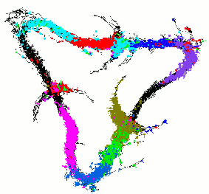
The Hippocampus (Seahorse)
Spatial Memory
Skaggs, McNaughton, Wilson and Barnes (1996)
Recordings from seven cells from a single electrode in the hippocampus of a rat as it moves several hundred times around a triangular maze.
Different colours represent the firing of different cells.
Hippocampus of the rat builds up a mental spatial representation of the maze.

Slide 19
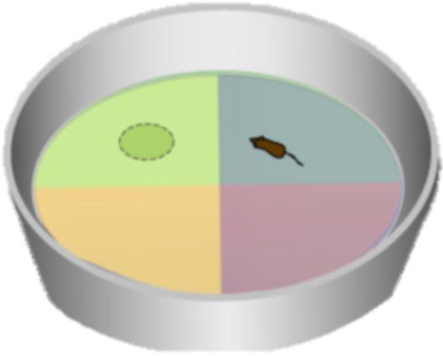
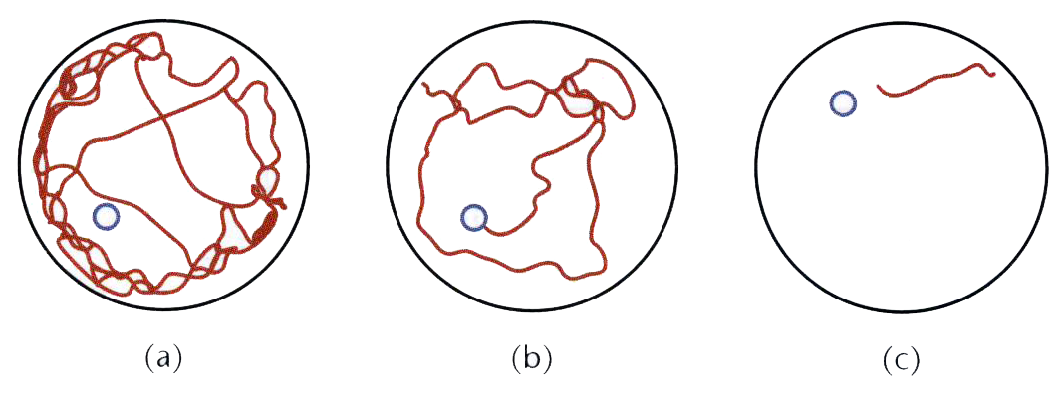
The Hippocampus (Seahorse)
Spatial Memory
Morris Water Maze
Rat is placed in the maze and swims until it finds the submerged platform.
A) Random swim-path after 5 trials. B) More efficient after 35 trials. C) After 71 perfect.

Slide 20
The Hippocampus (Seahorse)
Spatial Memory
Morris Water Maze
If the hippocampus is damaged in the rat that has learned the location of the platform it reverts to random patterns of searching – in fact it forgets that there is a platform at all (Clark, Broadbent & Squire, 2007)

Slide 21
The Hippocampus (Seahorse)
Contextual Memory
If you were to describe an event from today or yesterday it would contain more contextual detail (e.g., who was there, weather, conversations) than if you were to describe a similar event from 5 years ago which contain more of the gist of the memory.
Recent memories depend more on the hippocampus whereas remote memories are more dependent of the cerebral cortex.
Trained rats respond best in the same environment (context-dependent hippocampal memory) after a short delay, but after a long delay it makes no difference (cortical dependent memory).
Rats with damage to the hippocampus show no benefit of context.
Notes:
Baddeley tested divers on memory for information encoded in the swimming pool. They performed better when tested in the same context.

Slide 22
The Hippocampus (Seahorse)
Summary
The hippocampus supports:
Explicit, Declarative, Episodic Memory
Spatial Memory
Memory for Contextual Information

Slide 23
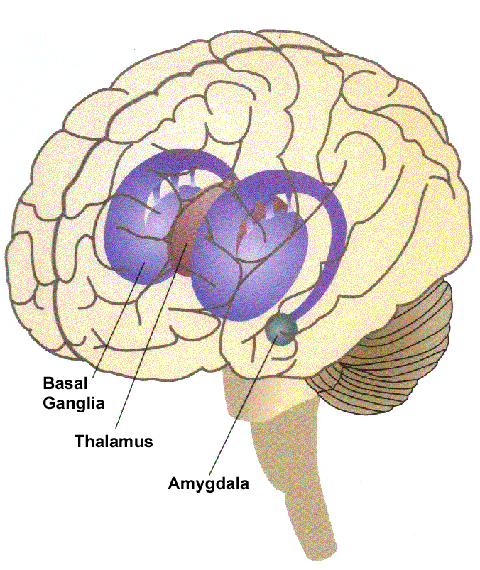
The Basal Ganglia
Situated at the base of the forebrain. Basal ganglia are strongly interconnected with the cerebral cortex, thalamus, and brainstem, as well as several other brain areas.

Slide 24
The Basal Ganglia
Some situations require the use of knowledge build up over many prior experiences – predicting the probability of an opponent’s response in sport to a given situation.
Here episodic memory of a past move may not be sufficient as it takes many, many episodes to generate a reliable response model.
This sort of learning takes place gradually.
Reflected in IMPLICIT learning.
Notes:
Second season issues in new players in the premier league – opponents build up a better model of their probable behaviour after a season playing against them.

Slide 25
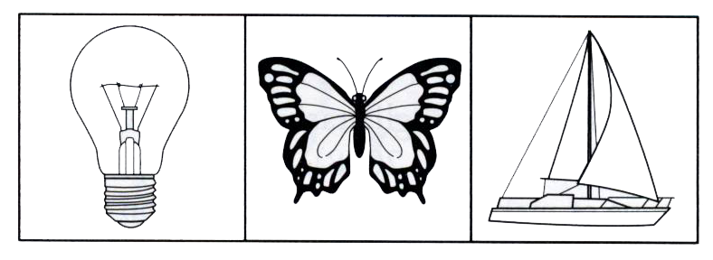
The Basal Ganglia
Probabilistic Learning – The Weather Task
Participants given three or four pieces of information (symbols) and are required to predict the weather (sun/rain).
None of the images alone allows total accuracy.
So participants must build up a probabilistic model of different combinations of image that best predict the weather.

Slide 26
The Basal Ganglia
Probabilistic Learning – The Weather Task
If a lightbulb rather than a candle it will probably rain
If a butterfly rather than a fish it will probably rain
If a boat rather than a plane it will probably rain
Forecast: Rain

Slide 27
The Basal Ganglia
Probabilistic Learning – The Weather Task
Normal participants tend to initially focus on one image and they are correct most of the time – use declarative, episodic (hippocampal) memory for this.
After many repetitions they approach 100% accuracy but appear unable to declare their strategy.
Basal ganglia seems to learn the patterns implicitly.
Parkinsons disease patients (damage to basal ganglia) continue to adopt the declarative memory strategy (intact hippocampus) even after many trials so never approach total accuracy.

Slide 28
The Basal Ganglia
Probabilistic Learning – The Weather Task
Conversely, amnesics with hippocampal damage are unable to use the declarative memory strategy initially. But if they continue for long enough they do show gradual improvements through use of intact basal ganglia.
Demonstrates that:
Hippocampus important for explicit/declarative memory
Basal Ganglia important for implicit/procedural memory
But most tasks will require BOTH types of memory and therefore hippocampal AND basal ganglia function.

Slide 29
Korsakoff’s Syndrome
Caused by prolonged Thiamine (Vitamin B₁) deficiency. Thiamine is extracted from a normal dietary intake of foods. It allows the brain to metabolize glucose. Chronic alcoholism is characterized by long periods where the diet is restricted to alcohol alone and thus devoid of thiamine.
Prolonged thiamine deficiency leads to a reduction of neurons throughout the brain – in particular the dorsomedial thalamus which inputs to the prefrontal cortex.
Therefore Korsakoff’s syndrome resembles cases of damage to the prefrontal cortex. This includes apathy, confusion and memory loss. In addition Korsakoff’s is also characterized by confabulation.
Confabulations more prevalent in episodic than semantic memory (Borzutsky et al., 2008).
Notes:
Confabulation is providing plausible memory cobbled together from past experiences and known facts but that didn’t really happen in the event being described..

Slide 30
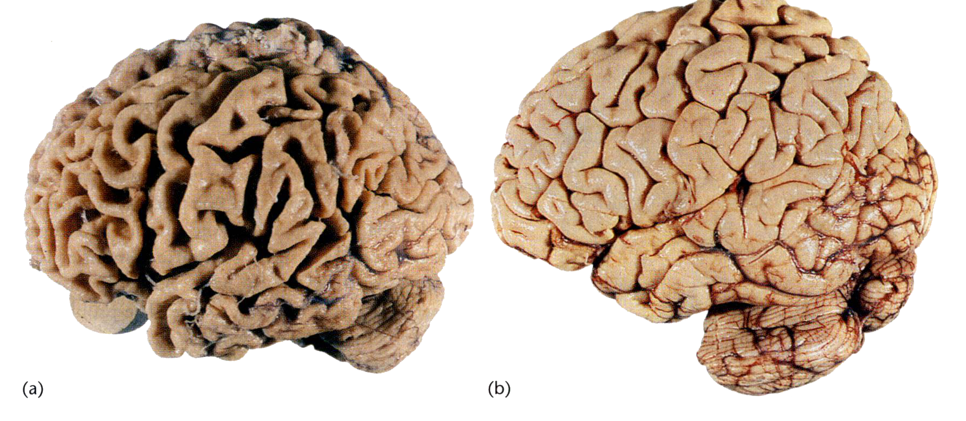
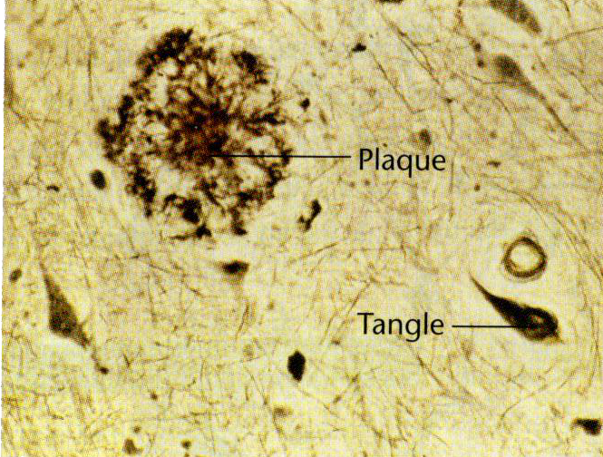
Alzheimer’s Disease
Alzheimers
Normal
Linked to the accumulation of the protein amyloid-β inside and outside of the neurons. This can damage dendritic trees and decrease synaptic input.
Damaged structures cluster into plaques and as these accumulate the cortex, hippocampus and other areas atrophy.
Also, increased amyloid leads to increased binding of phosphates to tau proteins. Altered tau can’t bind to axon sites so begins to migrate into the cell body and dendrites where it creates tangles. Increase in altered tau also increases amyloid production.

Slide 31
Alzheimer’s Disease
Alzheimers patients memory loss is more severe for declarative than procedural memory.
They can learn new skills but are often surprised by their abilities.
http://www.alz.org/news_and_events_16202.asp

Slide 32
Temporal Lobe and Memory
Damage to the temporal cortex characterized by a loss of semantic memory.
Patients with damage to anterior and inferior temporal lobe bilaterally have problems in specifying the colours of common fruits and vegetables or the appearance of animals.
Note that damage needs to be bilateral as unilateral patients perform in the normal range (Ralph et al., 2010).
The anterior and inferior temporal lobe region stores some information but also integrates information from other regions to represent conceptual knowledge.

Slide 33
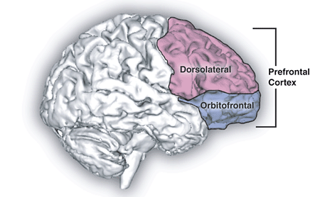
Prefrontal Cortex, Reward and Memory
While the Basal Ganglia learns about reward over longer time periods, the prefrontal cortex learns more rapidly.
Cells respond based on how a reward relates to other choices available.
10p
£1
£2
£2
£10
£20
Orbitofrontal cortex cells also related to self control. Given a small reward immediately or a larger reward later OFC will maximize reward.
OFC matures slowly so children are unable to control their impulses

Slide 34
Summary
Different types of memory (LTM/STM, Declarative, Procedural, Episodic, Semantic, Explicit/Implicit) associated with different brain areas. Damage to these areas results in amnesia or other memory deficits.
Hippocampus – LTM, Declarative, Episodic, Spatial, Explicit Learning
Basal Ganglia – LTM, Procedural, Semantic, Implicit Learning
Prefrontal Cortex – Working Memory and Reward Learning
Temporal Cortex – Semantic/Conceptual Knowledge

Slide 35
Lecture 11: Learning and Memory
Reading: Kalat, Chapter 13

